Slide 1
Multi Energy Systems: Investigating Hidden Flexibilities Provided by Power-to-X Considering Grid Support Strategies
MSc: Bekir Caner Yagci (4857089)
PhD: Digvijay Gusain
Supervisor: Asst. Prof. Milos Cvetkovic
Delft University of Technology
Faculty of Electrical Engineering,
Mathematics, and Computer Science

Slide 2
Research Problem
With increasing share of renewable energy, power balance became more challenging for grid operators
Replacing production based on fossil fuels in industries, such as chemicals, petrochemicals, food, steel cement; large-scale electrification(P2X) leads to more sustainable industrial complex and provides the necessary flexibility in the new energy system
Due to approximations made in model formulations, flexibilities provided by MES components to network can be concealed in the simulation results (hidden flexibility)
Inaccurate flexibility analysis of P2X may lead to increased transmission losses, higher operational cost or misinterpretation of MES capacity
(Palensky & Dietrich, 2011) suggests that, a good combination of Market DR (price signals) and Physical DR (grid management) is necessary. Existing hierarchical management of MES models not considers energy cost of production(€/MWh). This results with unnecessary trading of electricity and increse in operational cost
MES: Multi Energy System
P2X: Power-to-X
DR: Demand Response

Slide 3
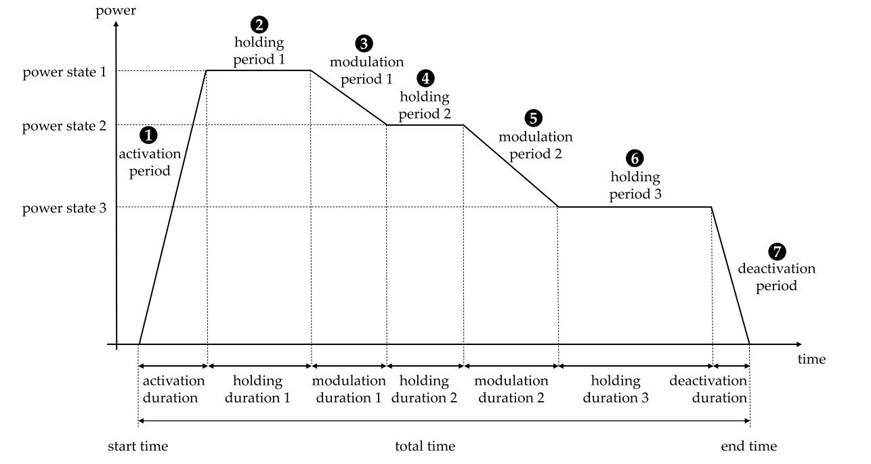
Flexibility
”Flexibility is ability of a component or a collection of components to response challenges caused by power fluctuations in energy systems. ”
” Hidden flexibility is the difference between the amount of energy consumed/stored by the simplified and the detailed model of P2X during flexibility service. ”
RE: Renewable Energy
P2X: Power-to-X
Fig. an exemplary flexible load measure with the corresponding parameters [1]

Slide 4
Research Questions
What options exist for minimizing curtailment of renewables in MES?
Which options are available in industrial area?
Which option has the best performance for the grid and the most profit for the P2X owner?
How much model detail impacts the flexibility analysis?
What should be the detail of a model (heat pump, electrolyser) for desired MES analysis?
What is the optimal deployment of flexibility in order to reduce operational cost for P2X owner?
What should be the control architecture of MES?
How can different energy domains can be combined and optimized for flexibility?
What are the dependencies between flexible load pairs?
MES: Multi Energy System
P2X: Power-to-X

Slide 5
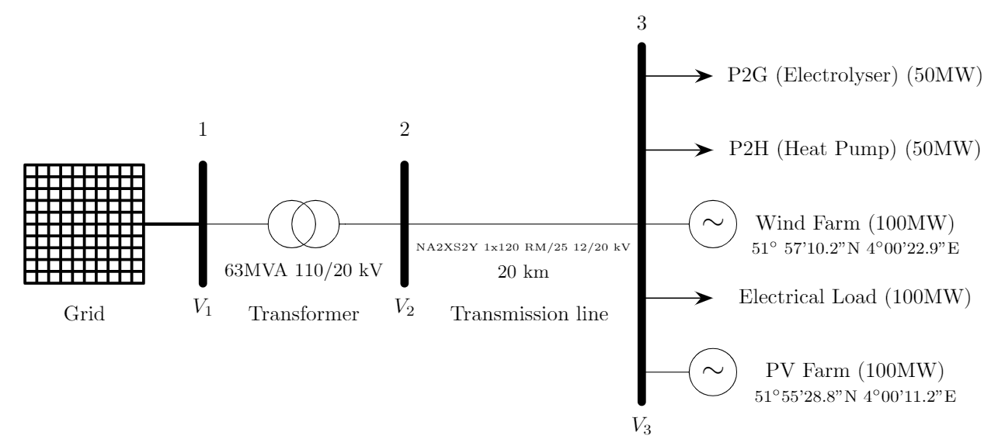
RQ1 – MES Design
About MES Design
RQ1 (P2X Selection): What options exist for minimizing curtailment of renewables in MES?
Which options are available in industrial area?
Which option has the best performance for the grid and the most profit for the P2X owner?
(Speech: To minimize curtailment, system flexibility must be increased. Electrification of industry is one of the best options to incerease this flexibility. However, there are so many options exist for electrification of industry, which option has the best performance for the grid and the most profit for the P2X owner needs to be investigated in order to decide which technology to model. So first I had to decide which P2X to model)
(Bode & Schmitz, 2018) compares different combinations of MES and concluded that, a combination of P2G with electric heat pumps or combined cycle gas turbines has the best cost performance in a MES with renewables.
MES: Multi Energy System
P2G: Power-to-Gas
P2H: Power-to-Heat
Notes:
The figure includes the
processes that allow for the storage and transport of electrical energy (Gray blocks)

Slide 6
RQ2 – Hidden Flexibility
About Modelling
(OM)
RQ2 (Hidden Flexibility): How much model detail impacts the flexibility analysis?
What should be the detail of a model (heat pump, electrolyser) for desired MES analysis?
(Speech: Hidden flexibility is the difference between the amount of energy consumed/stored by the simplified (linearized) and the detailed (first order dynamics) model of P2X during flexibility service. It is important to calculate flexible capacity correctly because miscalculation of flexibility may lead to increased tranmission losses for grid operator and operational cost for P2X owner. In this part, demand side does not follow generation but only operates at nominal power for a predefined (co-sim case1) holding duration.
 | Physical Domains | Modelling Approach | Dynamic Behaviour | Modelling Scale
Simple Model (Electrolyser) | Electrochemical Electrical | Analytic + Empirical | Static | Cell/Stack
Detailed Model (Electrolyser) | Electrochemical Electrical Thermal | Analytic + Empirical | Static + Dynamic (ODE) | Cell/Stack + BOP
MES: Multi Energy System
ODE: Ordinary Differential Equation
BOP: Balance of Plant
Notes:
The figure includes the
processes that allow for the storage and transport of electrical energy (Gray blocks)

Slide 7
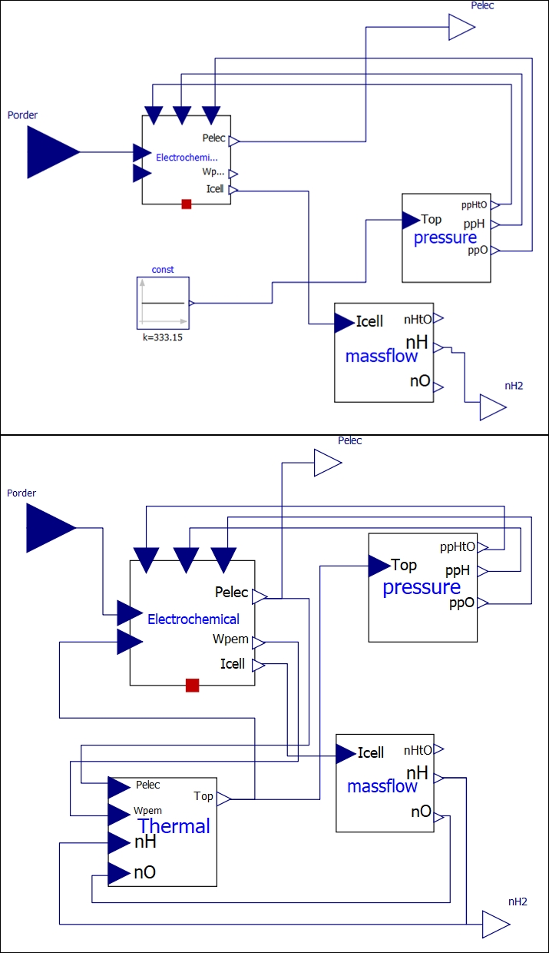
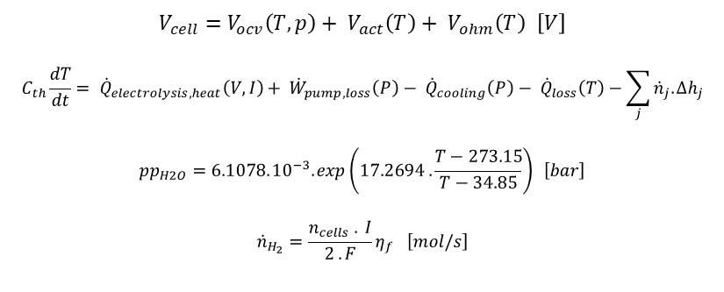
Electrolyser model
Simple model
Simple vs. Detailed Model
Thermal submodel
BOP: circulation pump, cooling
Static vs. First order dynamics
Temperature, Pressure, current effects
Detailed model
$$V_{cell}=V_{ocv}\left(T,p\right)+ V_{act}\left(T\right)+ V_{ohm}\left(T\right) \left[V\right]$$
$$C_{th}\frac{dT}{dt}= {\dot{Q}}_{electrolysis,heat}\left(V,I\right)+ {\dot{W}}_{pump,loss}\left(P\right)− {\dot{Q}}_{cooling}\left(P\right)− {\dot{Q}}_{loss}\left(T\right)−\sum_{j}{{\dot{n}}_{j}.{∆h}_{j}}$$
$${pp}_{H2O}=6.1078.{10}^{−3}. exp\left(17.2694 . \frac{T−273.15}{T−34.85}\right) \left[bar\right]$$
$${\dot{n}}_{H_{2}}=\frac{n_{cells} . I}{2 . F}η_{f} \left[mol/s\right]$$
BOP: Balance of Plant

Slide 8
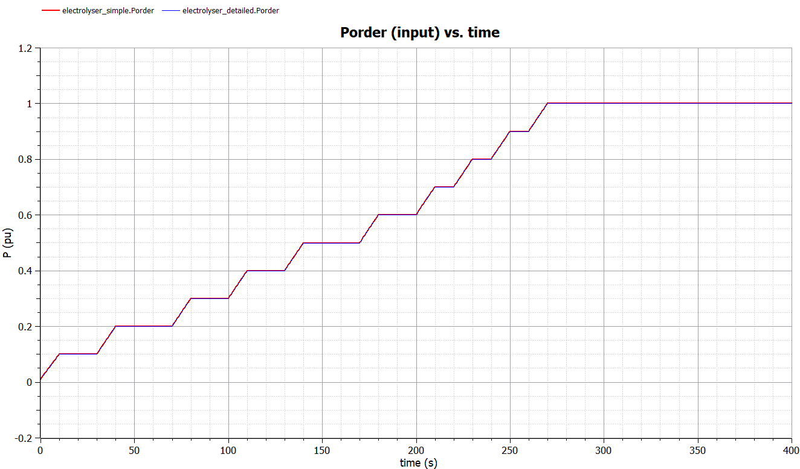
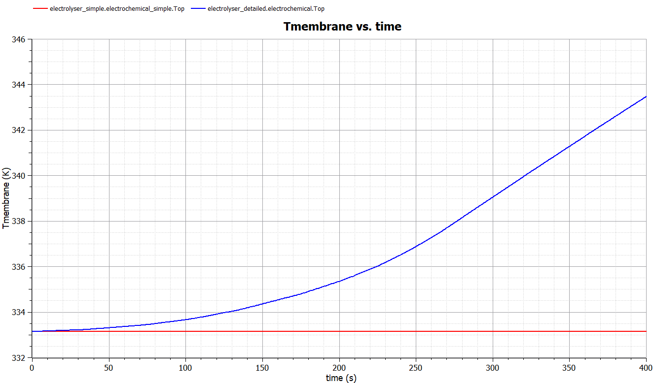
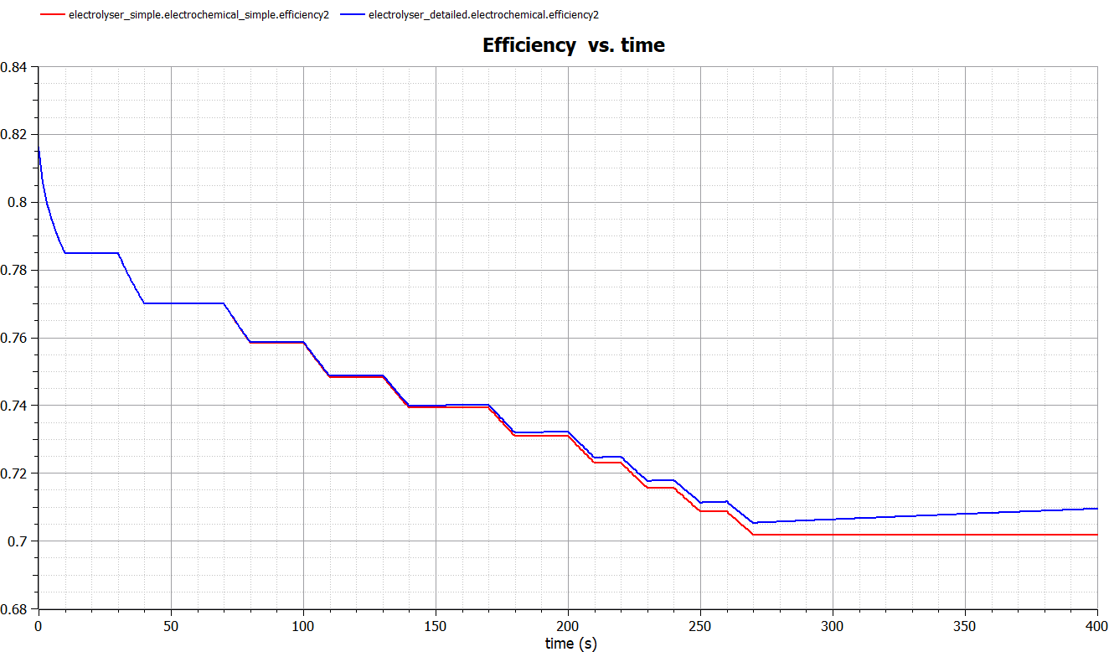
Electrolyser Model Comparison
Correct Evaluation of the operating temperature is important for the correct efficiency characterization of a P2X. I am investigating this effect in order to understand the true flexibility of P2X. Hidden flexibility can be understood as the operation temperature dependency of efficiency of a device. Therefore, correct modelling of temperature evoloution reveals the hidden flexibility.
What is the effect of this temperature dependancy on the flexibility results?

Slide 9
Hidden Flexibility Analysis
Base case:
Without any flexibility service, measuring the amount of excess RE with scheduled gas & heat demand profiles. None of the P2X available for flexibility service (static P2X).
First case (hidden flexibility):
For a given flexibility request, comparing the detailed model with simple model, and quantify hidden flexibility. Single P2X available for flexibility service.

Slide 10

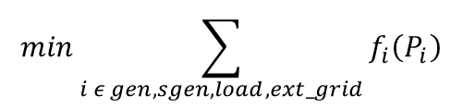
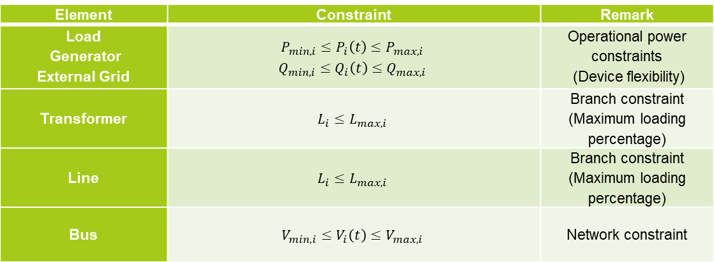
Optimum Deployment of Flexibility with Hierarchical Energy Management
I needed a parameter to decide how to share excess RE between both P2X optimally and that is the intraday market price signals. Because cost is the primary concern of the industry.This higher control level has to communicate with the agents and learn the adjustable power level in order to calculate the optimum operating point within that(adjustable power level) range. The active and reactive power generation of generators, loads, dc lines and static generators can be defined as a flexibility for the OPF.This function is provided by sending Pmin and Pmax data from Modelica Agents to Pandapower. Then pandapower sends active power order to the agents by solving optimal power flow.
$$min\sum_{i ε gen, sgen, load,ext_grid}{f_{i}\left(P_{i}\right)}$$
Objective function:
$$f_{pol}\left(p\right)=c_{n}p^{n}+…+c_{1}p+c_{0}$$
Cost function:
Constraints:
Element | Constraint | Remark
Load Generator External Grid | $$P_{min,i}≤P_{i}\left(t\right)≤P_{max,i}$$ $$Q_{min,i}≤Q_{i}\left(t\right)≤Q_{max,i}$$ | Operational power constraints (Device flexibility)
Transformer | $$L_{i}≤L_{max,i}$$ | Branch constraint (Maximum loading percentage)
Line | $$L_{i}≤L_{max,i}$$ | Branch constraint (Maximum loading percentage)
Bus | $$V_{min,i}≤V_{i}\left(t\right)≤V_{max,i}$$ | Network constraint

Slide 11
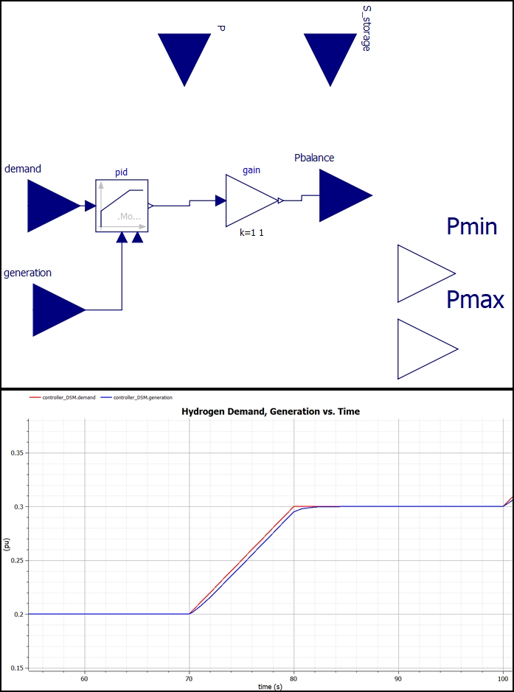
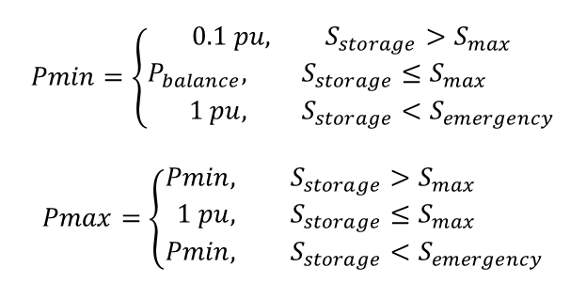
Adjustable Power Decision Making for Electrolyser
Controller.mo
Constraint decision:
$$Pmin=\left\{\begin{aligned}0.1 pu, &S_{storage}>S_{max} \\ \begin{aligned}P_{balance}, &S_{storage}≤S_{max} \\ 1 pu, &S_{storage}<S_{emergency}\end{aligned}\end{aligned}\right.$$
$$Pmax=\left\{\begin{aligned}Pmin, &S_{storage}>S_{max} \\ 1 pu, &S_{storage}≤S_{max} \\ Pmin, &S_{storage}<S_{emergency}\end{aligned}\right.$$

Slide 12
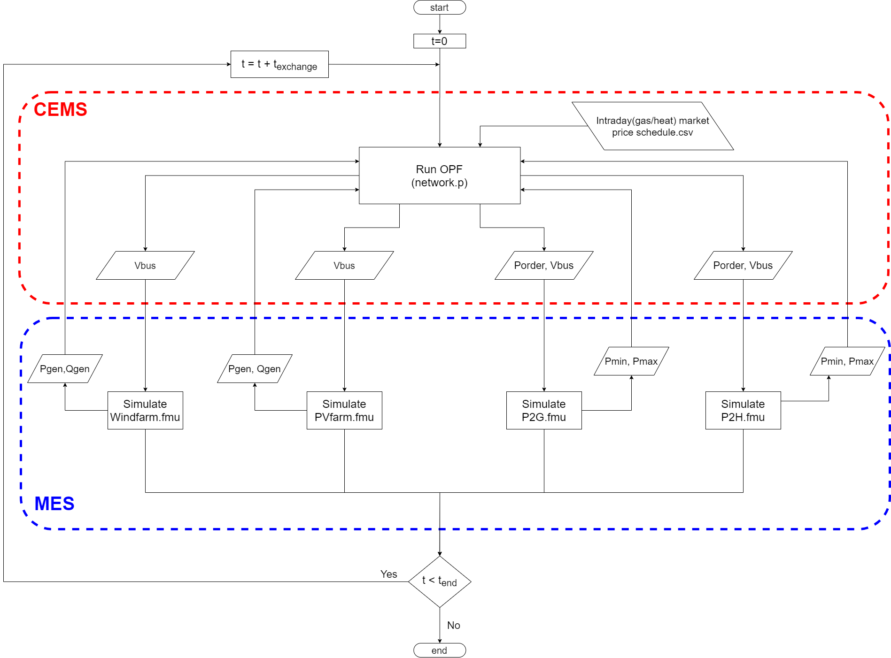
RQ3 – Optimal Deployment of Flexibility
About Simulation method
(Co-sim/ Energysim)
RQ3 (Optimal Deployment of Flexibility): What is the optimal deployment of flexibility in order to reduce operational cost?
What should be the control architecture of MES?
How can different energy domains can be combined and optimized for flexibility?
What are the dependencies between flexible load pairs?
(Speech: To run a network optimal, Market DR(price signals) should also be considered but it did not in the previous projects because, it increases the simulation setup complexity. This part is DSM for optimal deployment of flexibility. This part has no relation with hidden flexibility, but it investigates the optimum way to share excess RE between flexible loads considering Market DR with Physical DR at the same time.
The effect of simulation method on «flexibility deployment» in a MES with P2G & P2H.
MES: Multi Energy System
CEMS: Community Energy Management System
OPF: Optimal Power Flow
Notes:
The figure includes the
processes that allow for the storage and transport of electrical energy (Gray blocks)

Slide 13
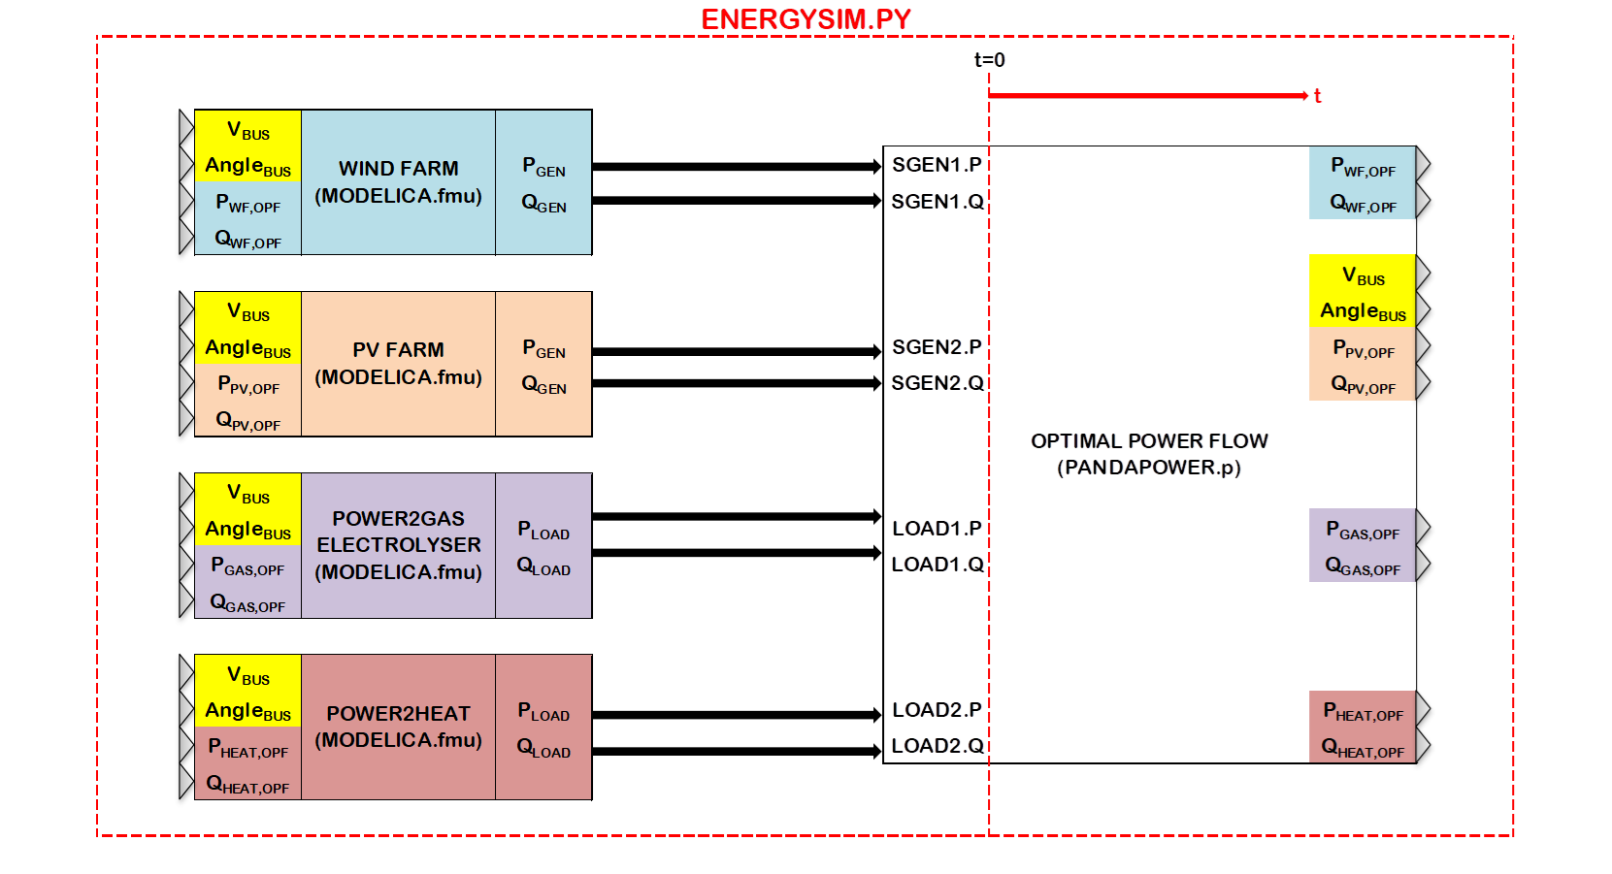
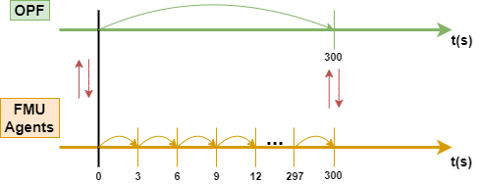
Simulation Tools
Having explained my model, I had to combine all agents in one environment in order to (simulate) investigate the flexibility service of the device within a MES with RES. Pandapower is responsible for the management of MES. Energysim allows me to combine all models and implement complex simulation in a relatively simple way by only using necessary i/o.
Pandapower
To solve optimal power flow problem and manage MES
OpenModelica
For fast simulation of complex dynamics from different energy domains, using object-oriented programming language
Energysim (Co-simulation)
Allows to implement complex simulations with reduced computational burden by using only necessary I/O’s
I/O: Input/Output
FMU: Functional Mock-up Unit
OPF: Optimal Power Flow

Slide 14
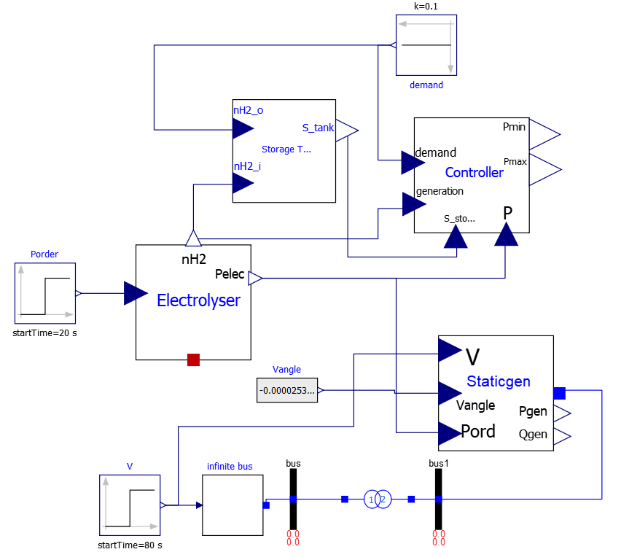
Power-to-Gas Model
Storage, calculates energy stored
Electrolyser, calculates electrical power consumed and H₂ flow rate
StaticGenerator, provides electrical interface and controls Qload
Controller, calculates Pmin, Pmax constraints for PandaPower

Slide 15
Optimal Deployment of Flexiblity
Second case (optimal deployment of flexibility):
With Market DR (price signals) and adjustable power level control, measuring the amount of shared flexibility between P2G & P2H and quantify the reduction in total operational cost. Both P2X available for flexibility service
Base case:
Without any flexibility service, measuring the amount of excess RE with scheduled gas & heat demand profiles, None of the P2X available for flexibility service.
First case (hidden flexibility):
For a given flexibility request, comparing the developed model with simple models, and quantify hidden flexibility. Single P2X available for flexibility service.
MES: Multi Energy System
P2G: Power-to-Gas
P2H: Power-to-Heat

Slide 16
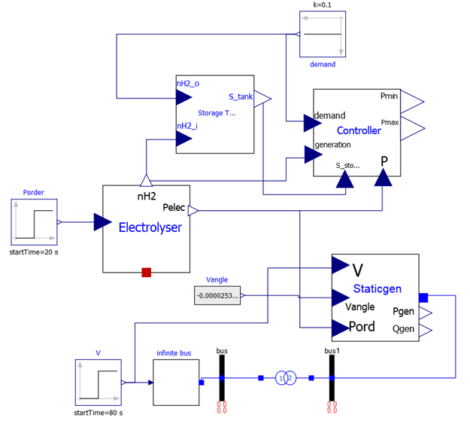
Future Plans
Must:
Finalize P2H.fmu model
Create input files from historical data (windspeed.txt, solar irradiation.txt, demand profiles.csv)
Combine models in Energysim for co-simulation, flexibility analysis
Further improvements:
Add more detail to models
Improve resolution of weather data

Slide 17
References
[1] P. Schott, J. Sedlmeir, N. Strobel, T. Weber, G. Fridgen, and E. Abele, “A generic data model for describing flexibility in power markets,” Energies, vol. 12, no. 10, pp. 1–29, 2019.
[2] P. D. Lund, J. Lindgren, J. Mikkola, and J. Salpakari, “Review of energy system flexibility measures to enable high levels of variable renewable electricity,” Renew. Sustain. Energy Rev., vol. 45, pp. 785–807, 2015.
[3] Gusain, D, Cvetković, M & Palensky, P 2019, Energy flexibility analysis using FMUWorld. in 2019 IEEE Milan PowerTech., 8810433, IEEE, 2019 IEEE Milan PowerTech, PowerTech 2019, Milan, Italy, 23/06/19. https://doi.org/10.1109/PTC.2019.8810433
[4] P. Dubucq and G. Ackermann, “Frequency control in coupled energy systems with high penetration of renewable energies,” 5th Int. Conf. Clean Electr. Power Renew. Energy Resour. Impact, ICCEP 2015, pp. 326–332, 2015.
[5] C. Bode and G. Schmitz, “Dynamic simulation and comparison of different configurations for a coupled energy system with 100% renewables,” Energy Procedia, vol. 155, pp. 412–430, 2018.
[6] P. Palensky and D. Dietrich, “Demand side management: Demand response, intelligent energy systems, and smart loads,” IEEE Trans. Ind. Informatics, vol. 7, no. 3, pp. 381–388, 2011.

Slide 18
Multi Energy Systems: Investigating Hidden Flexibilities Provided by Power-to-X Considering Grid Support Strategies
MSc: Bekir Caner Yagci (4857089)
PhD: Digvijay Gusain
Supervisor: Asst. Prof. Milos Cvetkovic
E-mail: B.C.Yagci@student.tudelft.nl
Version Control: https://github.com/caneryagci/Multi-Energy-Systems-Thesis-Project.git

